Slide 1

Agile Presentation
Jacob Mueller
2/18/2022

Slide 2
Rubric
Finally, you have been asked to put together a PowerPoint presentation for the leadership at your company. You will start by explaining the key facets of the Scrum-agile approach. You will also contrast the waterfall and agile development approaches to help your leadership make an informed decision. You must use properly cited sources to support your points. In your presentation, be sure to address each of the following:
Explain the various roles on a Scrum-agile Team by identifying each role and describing its importance.
Explain how the various phases of the SDLC work in an agile approach. Be sure to identify each phase and describe its importance.
Describe how the process would have been different with a waterfall development approach rather than the agile approach you used. For instance, you might discuss how a particular problem in development would have proceeded differently.
Explain what factors you would consider when choosing a waterfall approach or an agile approach, using your course experience to back up your explanation.

Slide 3

Scrum-Agile Key Concepts
"In a nutshell, Scrum requires a Scrum Master to foster an environment where:
A Product Owner orders the work for a complex problem into a Product Backlog.
The Scrum Team turns a selection of the work into an Increment of value during a Sprint.
The Scrum Team and its stakeholders inspect the results and adjust for the next Sprint.
Repeat"

Slide 4

Key Concepts Continued
Transparency - clear lines of communication between all team members is established and maintained from early on in the project's lifetime
Inspection/Reflection - frequent reviews, conducted daily during daily standups with the scrum master and dev team, as well as at the end of each sprint by the managing parties.
Adaptation - the dev team is able to assess and estimate the hierarchy of the tasks gleaned from user stories and can adjust accordingly to changes in a current project or switch between two completely different projects.

Slide 5
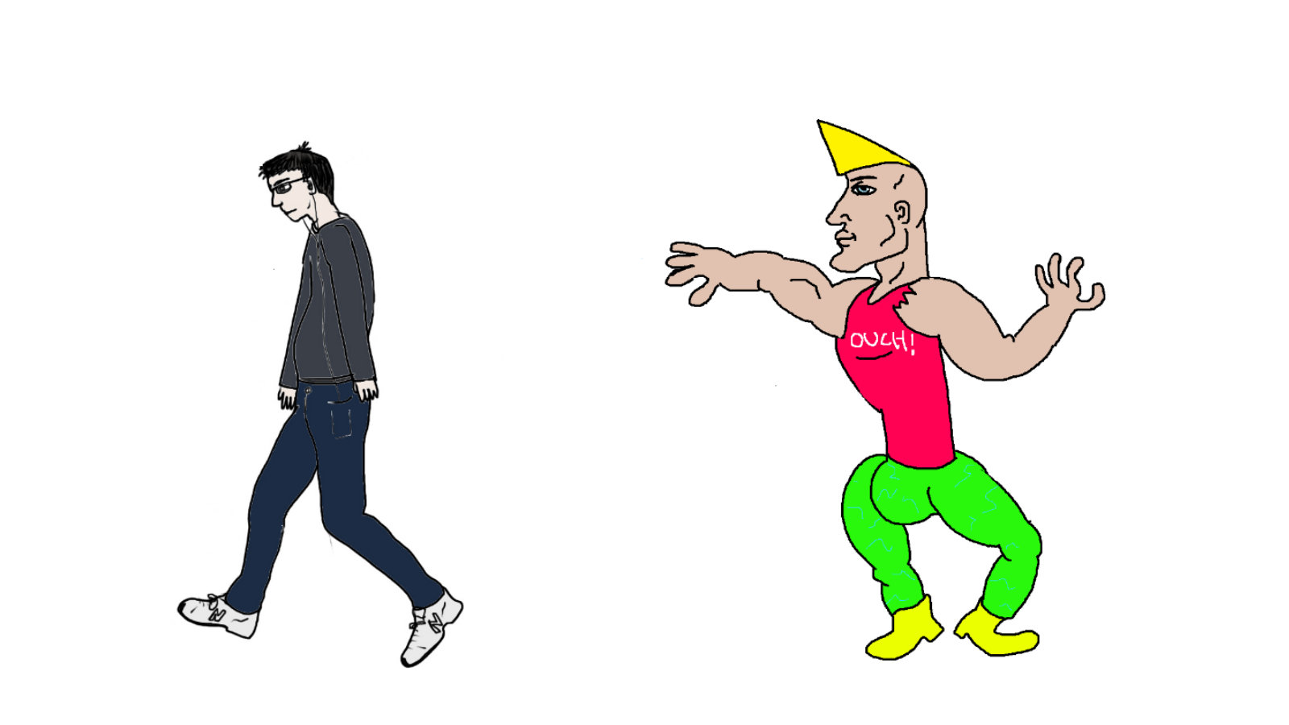
Traditional Waterfall Approach vs. Chad Agile Methodology
The waterfall approach is the tried and true methodology of yesteryear.
-no deviation
-no adjustment
-only the straightforward pursuit of the goal as planned
The agile approach is the cutting edge methodology of giants like Amazon.
-constant adjustment
-constant communication
-consumer happiness is paramount
-successful outputs are prioritized
-workflow and efficieny

Slide 6

Scrum-Agile Roles
Scrum Master: Organizes, leads, coaches, teaches, and communicates directly with the team. The eventual goal is to let the team operate on its own as an efficient unit, transitioning into a more managerial role. Acts a go-between for the dev team and the product owner.
Development Team: estimate and organize user stories into a manageable hierarchy of tasks to be completed. The eventual goal is for the team to gain experience and adjust to new challenges effectively.
Testers: Test the code and output of the development team. Managing expectations and outputs could lead testers to fill in PO or SM roles in the future.
Product Owner: manages product backlog (information on needs and expectations of customer), condenses info into user stories, communicating with dev team and end users to ensure the end product is the best it can be.

Slide 7
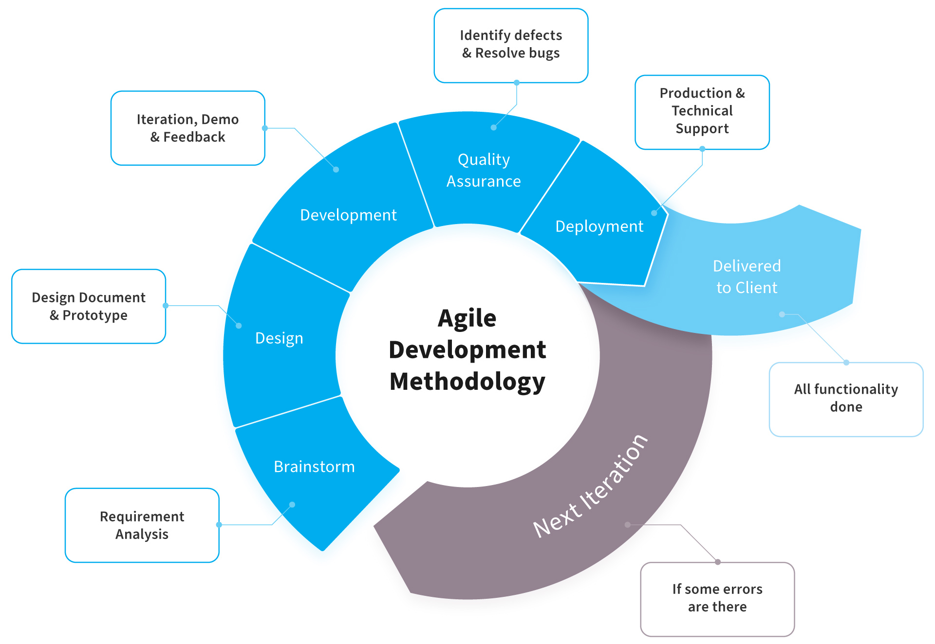
Software Development Life Cycle

Slide 8
Sprint Cycle
Planning & Brainstorm: During the initial formation of the sprint, after the stakeholders and managers have come to the main idea of the project and necessity of a team, the managers will work together to plan out the goals of the sprint. The scrum master is well versed in the process and the product owner is familiar the needs of the stakeholders, working together they form the overall shape of the sprint.
The Active Sprint: Includes all the small processes within the over-arching plot of the sprint: daily stand ups, estimations, design, coding, testing, etc. The development team is able to conduct small review sessions and build team rapport in daily stand up meetings, the outputs of the team will be thrown back and forth between the developers and the testers over the course of 1-4 weeks.
Review & Retrospective: The progress is measured by the team and the managers, and goals are adjusted or tabled as needed before the mangers meet with the stakeholders for further adjustments.
Repeat as needed: The planning process pics back up and the information from the review and retrospective process informs the shape of the next overall sprint.

Slide 9

Groundhog Day: Waterfall
Teams act out an extensive plan, developed without their input, until the goal is met.
Like Bill Murray, the changes that are made will take time, eventually showing progress and adaptation.
It does possess a distinct level of focus on a single issue that other methodologies miss out on.
Classic.

Slide 10

What if?: Scrum Agile
The scrum team is vaguer and susceptible to transformation/adaptation, the end product could be different than end user expectation.
Lacking direction means the teams will spend more time figuring out the project than a linear waterfall methodological team

Slide 11
Project Factors to consider
What are the constraints? (time, money, manpower, etc.)
Who are the end users? (varied, numerous, picky, etc.)
Current methodology (agile, waterfall, etc.)
Experience of team (adaptive themselves, communicative, self-starters)

